Slide 1
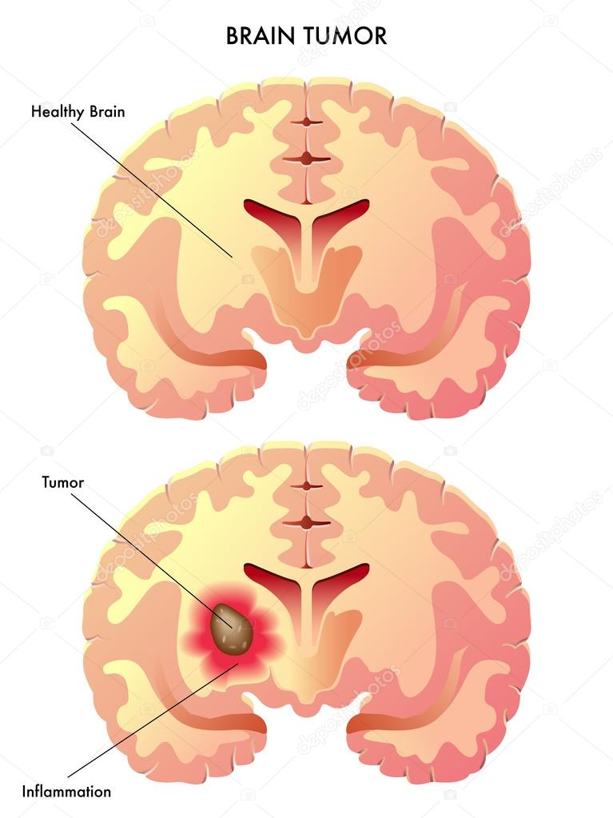
INTRODUCTION
Brain tumor is uneven or uncontrolled growth of the cells in the brain.
Brain tumors are detected using different techniques such as X-Ray,CT Scan, MRI.
Among these MRI is found reliable and safe.

Slide 2
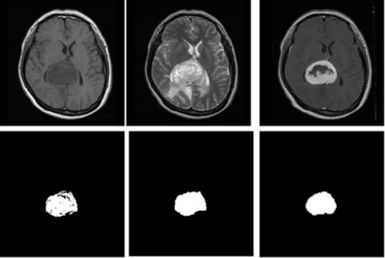
Brain tumor image dataset
Pre processing
(noise removal)
Feature Extraction
ROI
Segmentation
Feature Section
Fig: Flow chart of computer aided tumor prediction
‹#›

Slide 3
PROBLEM DEFINITION
The primary goal is to extract meaningful and accurate information from the scan images to detect tumor .
To help radiologists recognise the tumor, not just by mere manual examination of the scan reports but by automated detection.

Slide 4
PROBLEM METHODOLOGY
The automated prediction of tumor from MRI includes several stages such as:
Preprocessing: It is used to improve the quality of the MR images and make it in a form suited for further processing
Segmentation:The selected threshold are mapped to white, while others are marked as black; due to this two, different regions are formed around the infected tumor tissues, which is cropped out.
Feature extraction:To extract the useful data from the Image to improve the process of decision making.

Slide 5
METHODOLOGY CONT
MMMMMMMMMMMMMNMMMMMMMM
MR IMAGE
P
S
PREPROCESSING
SEGMENTATION
FEATURE EXTRACTION

Slide 6
Preprocessing
Z
MR IMAGE
Gray scaling
Thresholding

Slide 7
Segmentation
Threshold lmage
Noise removal
Set background area
Finding foreground
Marker labelling
Watershed image

Slide 8
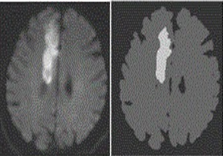

Feature Extraction
MR Image of Brain tumor
Extracted Image

Slide 9
MR IMAGE
PREPROCESSING
Noise Removal
Enhancement
SEGMENTATION
FEATURE EXTRACTION
OUTPUT
MACHINE LEARNING MODEL for Classification and segmentation
‹#›

Slide 10
CONCLUSION
Our system aims to have an automated system which plays a important role in assessing whether a lump (mass of tissue) in the brain could be benign (clump thickness) or malignant (marginal adhesion) by classification. Our proposed model uses machine learning algorithms in order to improve the accuracy of classification. The system is carried out in four steps to determine and classify the tumor as benign or malignant.

